Slide 1

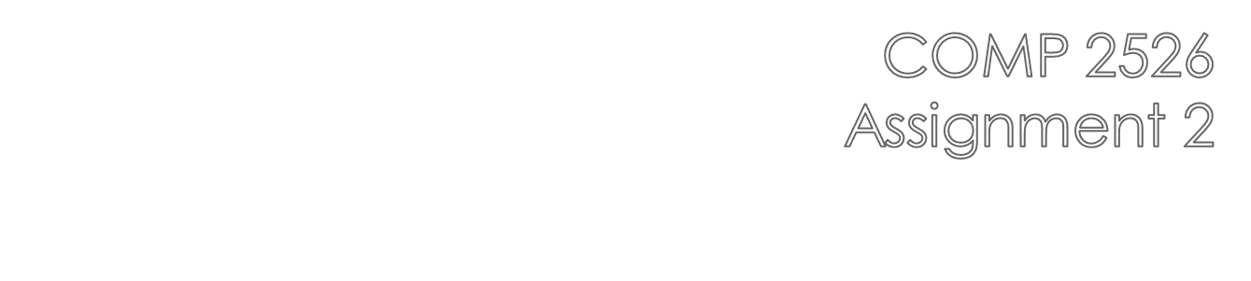

Slide 2

Assignment 2 will add a front end to the program we developed for Assignment 1.
The primary focus here is to build an UI to access the functionality we have already developed
Due date is July 31, 2012 11:59 p.m.
This will be assessed out of 15 marks

Slide 3

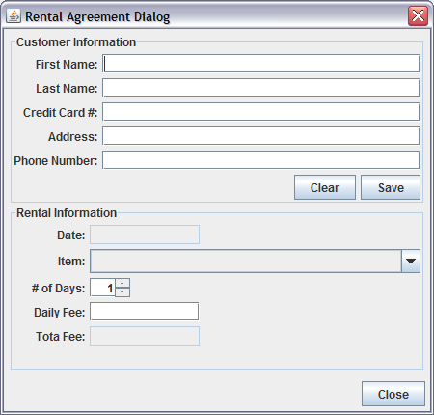
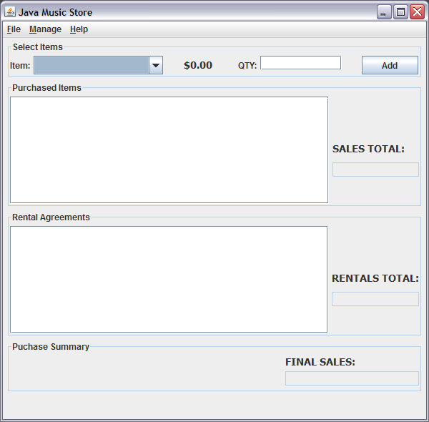
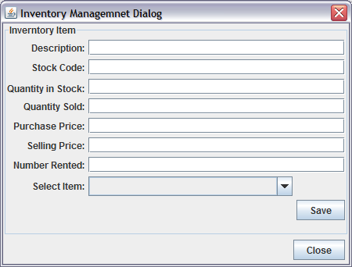

Slide 4

fields will display currently selected inventory item, or be used to enter data for a NEW inventory item
“Save” button will save new and altered inventory to the MusicalInstrument Collection
combo box will list all sorted inventory items by stock code
“Close” button will save the contents of the Collection to the file

Slide 5

fields are used to create a NEW Customer for rental agreements
“Clear” button clears the fields for starting over
“Save” button creates a new Customer and saves them to the RentalAgreement Object
Panel used to create a RentalAgreement Object
Date will be the System date
Combo box will list all items in inventory by stock code + description
Spinner will hold values 1 to 31

Slide 6

Panel will allow purchases to be made
Combo box hold sorted list of items by description
Dollar label display the item selling price
“Add” button will add the purchased item to the display area and ALSO update the SALES TOTAL and FINAL SALES total

Slide 7

Rental display will show all rental information including Customer Name
It is filled when a NEW RentalAgreement is made on the Rental Dialog
RENTAL TOTAL field will show the total of all rentals
FINAL SALES field will show the sum of all purchases and rentals

Slide 8

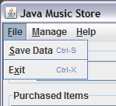
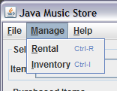
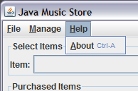
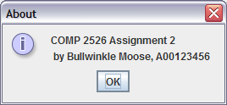
“Save Data” will save all Collection Data to the appropriate file
“Exit” will exit the application
“Rental” will display the Rental Dialog
“Inventory” will display the Inventory Dialog
“About” will display a JOptionPane like the one shown here

Slide 9

BEFORE the frame loads the inventory.txt file is read to create MusicalInstruments and the MusicalInstrument Collection is filled.
WHEN the frame loads the “Item” combo box in the purchase panel is filled with the sorted description from each MusicalInstrument in the Collection.
AS items are purchased the purchase display area, the SALES TOTAL field and the FINAL SALES field are all updated.

Slide 10

WHEN the Inventory Dialog displays the “Selected Items” combo box will be filled with sorted item stock codes. When a stock code is selected the fields are filled with the data for that item, which is read from the Collection
WHEN the “Save” button is clicked the fields are read and the item is updated in the Collection
IF the fields are empty and new data is entered, the “Save” button will create a new MusicalInstrument in the Collection
WHEN the “Close” button is clicked ALL MusicalInstruments in the Collection are saved to the inventory.txt file. If a new instrument is created the “Select Item” combo box and the “Item” combo box on the frame are updated

Slide 11

WHEN the dialog displays the date field show the current system date
The “Item” combo box displays the sorted description and stock code for all MusicalInstruments in the Collection
WHEN the “Save” button is clicked the customer is create and added to a NEW RentalAgreement
WHEN the “Close” button is clicked the ALL rental agreements are written from the RentalAgreement Collection to the rentals.txt file

Slide 12

The ShoppingCart class will still be used to hold the Collections required for this assignment.
All data validations that were required in Assignment 1 still apply in Assignment 2.
You DO NOT need to store purchase information in a file; only rental and inventory data.
If you have time, create a third Manage menu option and associated dialog to display All rental agreements currently in the Collection.

